Slide 1


Introduction to Probability
Instructor
Osama Bin Ajaz
(osama.ajaz@nu.edu.pk)
Lecturer, S & H Dept.,
FAST-NU, Main Campus

Slide 2
Probability
Probability is a measure of the chance that
an uncertain event will occur.
Subjective:
Personal experiences
Objective:
Classical approach

Slide 3
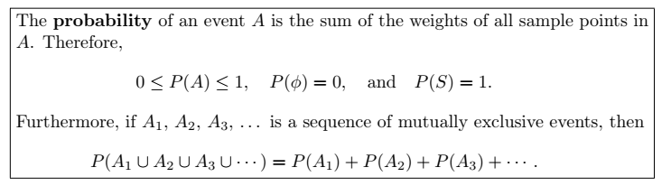

Slide 4
Examples (1 – 3)
A coin is tossed twice. What is the probability that at least 1 head occurs?
A die is tossed once. What is the probability of getting:
(a) an even number (b) a number less than 3 (c) a 4 or higher number (d) a 7 (e) A number from 1 to 6
3. A die is loaded in such a way that an even number is twice as likely to occur as an odd number. If E is the event that a number less than 4 occurs on a single toss of the die, find P(E).

Slide 5
Example 4
Two balanced dice are rolled once. What is the probability of getting
(a) A sum of 11 (b) same number on both dice (c) a sum of 13
Notes:
(a) 2/36=0.056 (b) 6/36=0.167 (d) 0

Slide 6

A deck of playing Cards

Slide 7
Example 5 – 6
5. A card is drawn at random from the well shuffled pack of 52 playing cards. Find the probability that the card:
(a) is a Jack (b) is not a Jack
6. In a poker hand consisting of 5 cards, find the probability of holding 2 aces and 3 jacks.
Notes:
(a) 4/52= (b) 12/13 (6) 0.00009

Slide 8
Example 7
A statistics class for engineers consists of 25 industrial, 10 mechanical, 10 electrical, and 8 civil engineering students. If a person is randomly selected by the instructor to answer a question, find the probability that the student chosen is (a) an industrial engineering major and (b) a civil engineering or an electrical engineering major.
Notes:
(a) 25/53 (b) P(C U E) = 18/53

Slide 9

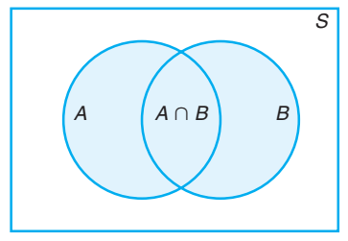
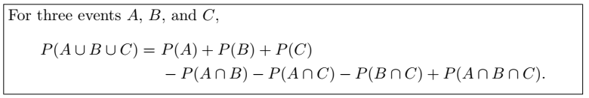
Additive Rule: Not - Mutually Exclusive Events

Slide 10

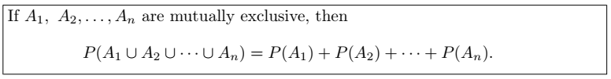
Additive Rule: Mutually Exclusive Events

Slide 11
Example # 08 – 10
8. John is going to graduate from an industrial engineering department in a university by the end of the semester. After being interviewed at two companies he likes, he assesses that his probability of getting an offer from company A is 0.8, and his probability of getting an offer from company B is 0.6. If he believes that the probability that he will get offers from both companies is 0.5, what is the probability that he will get at least one offer from these two companies?
What is the probability of getting a total of 7 or 11 when a pair of fair dice is tossed?
If the probabilities are, respectively, 0.09, 0.15, 0.21, and 0.23 that a person purchasing a new automobile will choose the color green, white, red, or blue, what is the probability that a given buyer will purchase a new automobile that comes in one of those colors?
Notes:
(8) 0.9 (not-Mutually) (9) (6 + 2)/36 (mutually)= 8/36 = 2/9 (10) Mutually = 0.68

Slide 12
Examples (11)
If the probabilities that an automobile mechanic will service 3, 4, 5, 6, 7, or 8 or more cars on any given workday are, respectively, 0.12, 0.19, 0.28, 0.24, 0.10, and 0.07, what is the probability that he will service at least 5 cars on his next day at work?
Notes:
P(E’) = 0.31 P(E) = 0.69

Slide 13
Example # 12: Specifications for length of cable
Suppose the manufacturer’s specifications for the length of a certain type of computer cable are 2000 ± 10 millimeters. In this industry, it is known that small cable is just as likely to be defective (not meeting specifications) as large cable. That is, the probability of randomly producing a cable with length exceeding 2010 millimeters is equal to the probability of producing a cable with length smaller than 1990 millimeters. The probability that the production procedure meets specifications is known to be 0.99.
(a) What is the probability that a cable selected randomly is too large? (b) What is the probability that a randomly selected cable is larger than 1990 millimeters?
Notes:
(12) P(S) = P(L) = 0.005 & P (X>1990) = 0.995

Slide 14
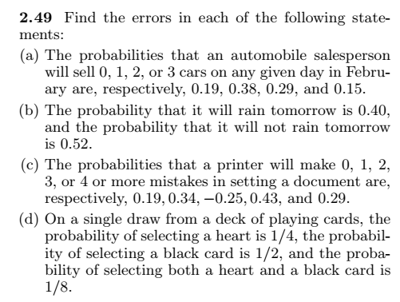
Exercises

Slide 15
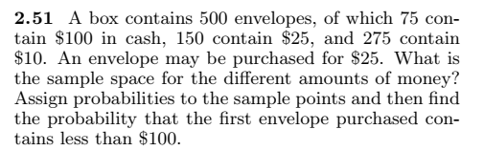
Notes:
S ={$10, $25, $100} 275/500 150/500 75/500 P(X<$100)=3/10

Slide 16

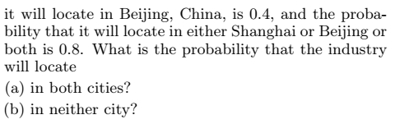
Notes:
(a) P(S&B) = 0.3 (b) P(S’&B’) = 0.2

Slide 17
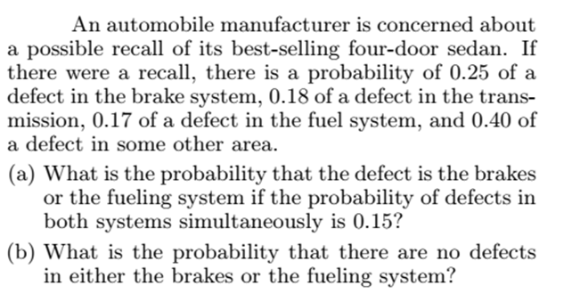
Notes:
(a) P (A U B) = 0.27 (b) P (No defect ) = 1 – P(AUB) = 0.73

Slide 18
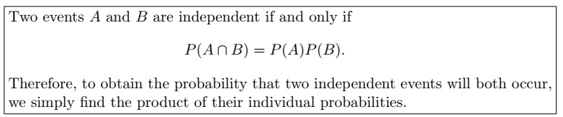
The Product Rule: Independent Events

Slide 19
Some important results for Independent events
(i) A’ and B are independent = P (A’∩ B ) = P(A’).P(B)
(ii) A and B’ are independent = P (A ∩ B’) = P(A).P(B’)
(iii) A’ and B’ are independent = P(A’ ∩ B’) = P(A’).P(B’)
If A and B are independent then they are not mutually exclusive.
If A, B, and C are independent, then P(A ∩B ∩ C)’ = 1 - P(A).P(B).P(C)
If A, B, and C are independent, then P (A U B U C) = 1 – P(A’ ∩ B’ ∩ C’)

Slide 20

Relationship among events

Slide 21
Examples # 13 – 14
A small town has one fire engine and one ambulance available for emergencies. The probability that the fire engine is available when needed is 0.98, and the probability that the ambulance is available when called is 0.92. In the event of an injury resulting from a burning building, find the probability that both the ambulance and the fire engine will be available, assuming they operate independently.
A bag contains 5 red and 7 black balls. A ball is drawn at random from the bag, the color is noted and the ball is replaced. A second balls is then drawn. Find the probability that the first balls is red and the second is black.
Notes:
P(A&B) = 0.98*0.92 = 0.9016 (14) P(A&B) = 35/144

Slide 22


Slide 23
Examples 15 & 16
(15). A die is rolled two times. Find the probability of obtaining a 5 on the first thrown and an even number on the second thrown.
(16). The probability that Ahsan will be alive in 30 years is 0.4 and the probability that Bilawal will be alive in 30 years is 0.8. What is the probability that:
(a) both will be alive in 30 years
(b) both of them die
(c) Ahsan will be alive and B dead.
Notes:
(15) ½ (16) (a) 0.32, (b) 0.08

Slide 24
Example # 17: Fire Engines
A town has two fire engines operating independently. The probability that a specific engine is available when needed is
0.96.
(a) What is the probability that neither is available when needed?
(b) What is the probability that a fire engine is available when needed?
Notes:
P(neither available = A’&B”) = 1 – 0.96 = 0.004, (a) [0.04][0.04]=0.0016 (b)P(available when needed)=1 – P(A’&B’) = 0.9984.

Slide 25
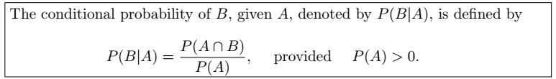
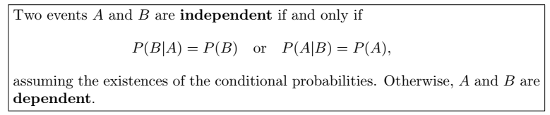
The Product Rule: Dependent Events

Slide 26
Example # (18 – 20)
(18). Suppose that we have a fuse box containing 20 fuses, of which 5 are defective. If 2 fuses are selected at random and removed from the box in succession without replacing the first, what is the probability that both fuses are defective?
(19). Two cards are drawn in succession from a deck of 52 playing cards without replacement. What is the probability that both cards a are spades.
(20). A box contains 8 tickets bearing the numbers 1, 2, 3, 4, 5, 6, 8, 10. One ticket is drawn and kept aside. Then a second ticket is drawn. What is the probability that both the tickets show even numbers.
Notes:
(18) 1/19. (19). 1/17 (20). 5/14

Slide 27
Example # 21
(21). In a certain college 25% of the students passed Mathematics, 15% of the students passed statistics and 10% of the students passed both mathematics and Statistics. A students is selected at random.
(a) if he passed statistics, what is the probability that he passed mathematics.
(b) if he passed mathematics, what is the probability that he passed statistics.
(22). Suppose a pair of dice is tossed once. If it is known that one die shows a 3. what is the probability that other die shows a 6.
Notes:
(21) a. 0.10/0.15 = 2/3 (b) 2/5 (22) P(B\A) = [2/36]/11/36 = 2/11

Slide 28
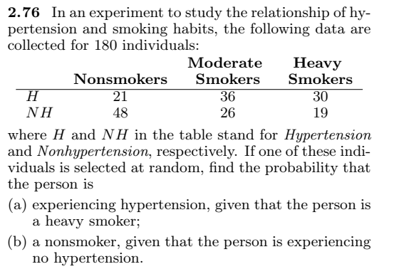
Example # 22
Notes:
P(A\B) = 30/49. P(c\A’)=48/93 total = 180

Slide 29
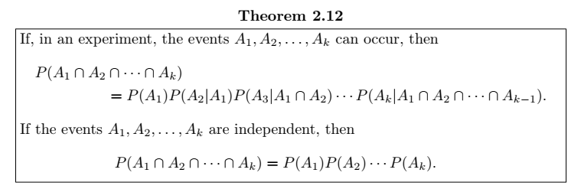
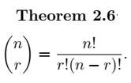
Example # 23
(2.91) Find the probability of randomly selecting 4 good quarts of milk in succession from a cooler containing 20 quarts of which 5 have spoiled, by using
(a) the first formula of Theorem 2.12 on page 68.
(b) the formula of Theorem 2.6 on page 50.
Notes:
(a) 91/323 (b) 91/323

Slide 30


Slide 31
Example # 23
A card is drawn is random from a deck of ordinary playing cards. What is the probability that it is a diamond, a face card or a king?
Solution:
Let A = the card drawn is diamond
B = the card drawn is face card, &
C = the card drawn is a king
P (A U B U C) =
Notes:
P(A) = 13/52 P(B) = 12/52 P(C)=4/52 P(A∩B)=3/52 P(A∩C) = 1/52, P(B∩C) = 4/52, P(A∩B∩C) = 1/52
P (A U B U C ) = 22/52 = 0.423

Slide 32
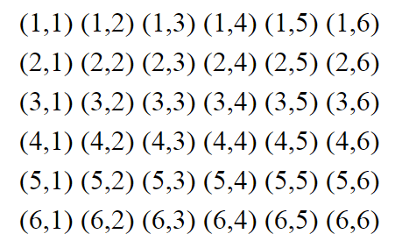
Example # 24
A man tosses two fair dice. What is the conditional probability that the sum of two dice will be 7, given that
(i) the sum is odd. (B)
(ii) the sum is greater than 6. (C)
(iii) the two dice had the same outcome. (D)
Solution:
Notes:
P(A|B) = (6/36)*(36/18) = 1/3 P(A|C) = (6/36)*(21/36) P(A|D) = 0 * (36/6) = 0

Slide 33
Example # 25
Two coins are tossed. What is the conditional probability that two heads results, given that there is at least one head?
Notes:
P(A∩B) = ¼ = {HH} P(B) = ¾ P(A|B) = 1/3

Slide 34
Example # 25
Two events A & B are such that P(A) = 1/4, P(A|B)=1/2, P(B|A) = 2/3
Are A and B independent events?
Are A and B mutually exclusive events?
Find P(A∩B)
Notes:
(i) Not independent, P(A) not equal to P(A|B) (ii) if mutually exclusive then it should be P(A|B) = 0 but here P(A|B) = 1/2 (iii) P(A∩B)=P(A).P(B|A) = 1/6

Slide 35
Example # 26
In a certain assembly plant, three machines, B1, B2, and B3, make 30%, 45%, and 25%, respectively, of the products. It is known from past experience that 2%, 3%, and 2% of the products made by each machine, respectively, are defective. Now, suppose that a finished product is randomly selected. What is the probability that it is defective?
Solution:
A: the product is defective, B1: the product is made by machine B1, B2: the product is made by machine B2, B3: the product is made by machine B3,
Notes:
0.0245.

Slide 36
Tree Diagram for Example # 26
P(A|B1) = 0.02
P(B1) = 0.3
P(A|B2) = 0.03
P(B2) = 0.45
P(B3) = 0.25
P(A|B3) = 0.02

Slide 37
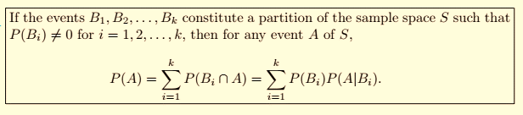
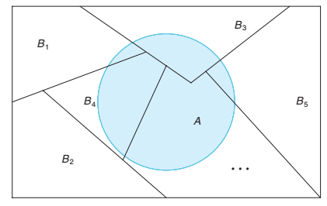
Theorem of Total Probability

Slide 38
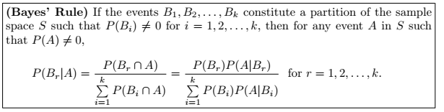
Baye’s Rule

Slide 39

Example # 27
In a certain assembly plant, three machines, B1, B2, and B3, make 30%, 45%, and 25%, respectively, of the products. It is known from past experience that 2%, 3%, and 2% of the products made by each machine, respectively, are defective. Now, suppose that a finished product is randomly selected. What is the probability that it is defective? if a product was chosen randomly and found to be defective, what is the probability that it was made by machine B3?
Solution:
Notes:
P(B3|A) = 10/49

Slide 40
Example # 28
Suppose a Software House based in Karachi required the post of Programmer. After interviewing many applicants, the firm has identified 20 applicants categorized as in the following contingency table:
If a diploma holder is selected, what is the probability that the person is a Male.
 | Certificate | Diploma | Total
Male | 10 | 2 | 12
Female | 5 | 3 | 8
Total | 15 | 5 | 20
Notes:
P(D) = P(D∩M) + P(D∩F) = 0.10 + 0.15 = 0.25 P(M∩B) = 0.10 P(M|D) = 0.4

Slide 41
Example # 29
Suppose 25 colored balls are distributed in three bags, which are identical in appearance as follows:
A bag is selected as random from which a ball is drawn at random.
Find the probability that the ball is yellow.
Given that ball is yellow, what is the probability that bag 2 was selected.
 | BAG
 | 1 | 2 | 3 | Total
Green | 1 | 3 | 4 | 8
Yellow | 2 | 2 | 3 | 7
Red | 4 | 5 | 1 | 10
Total | 7 | 10 | 8 | 25
Notes:
P(B1=B2=B3) = 1/3, (a) P(Y) = 0.2869 (B) PB2|Y) =0.23

Slide 42
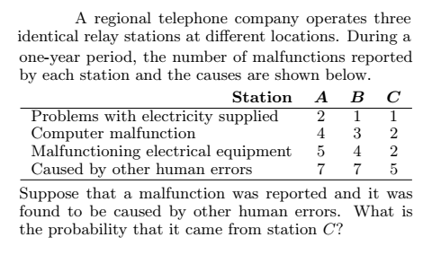
Notes:
0.2632 = P(C|E)

Slide 43
P(A U B) = P(A) + P(B) – P(A intersection B)
Proof:
Notes:
A U B = A U (B intersection A’) eq(1)

Slide 44
Prove that P(A|B) = P(A) for independent events

Slide 45
Prove rules of Multiplication for probability
Suppose A & B represent two events, then
P(A∩B) = P(A).P(B|A) → dependent events
Proof:

